Slide 1


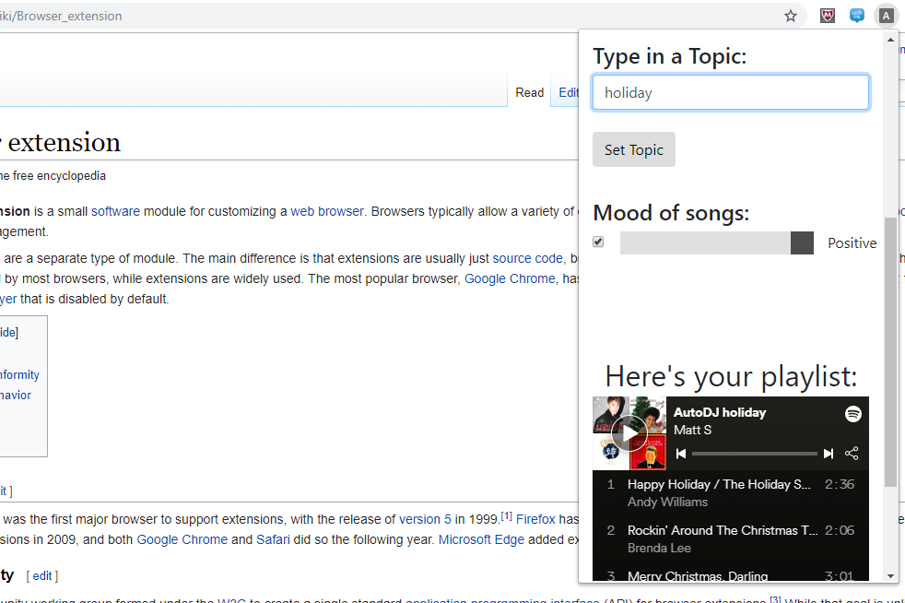

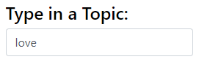





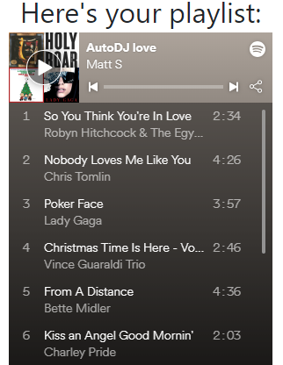



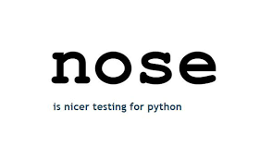
AutoDJ Playlist Generator
Craig Dunton, Nick Bova, Steven Sun, Matthew Stock
–
THE OHIO STATE UNIVERSITY / COLLEGE OF ENGINEERING / COMPUTER SCIENCE AND ENGINEERING
INTRODUCTION
AutoDJ is a playlist creation tool which helps users find the music that they want to listen to. AutoDJ dynamically creates song playlists by using IBM Watson Discovery to query a database for music concepts and themes. AutoDJ also integrates with Spotify’s API to automatically post playlists to a user’s account, and allows users to play music using the Spotify web player.
DESIGN
Languages and Technologies:
Python
Flask
jQuery
Travis
Pytest
INTERACTION
Users can specify a topic or concept that will be used to query the Watson Discovery backend. Also, users can specify a mood as another query parameter, allowing them to tailor the results to their liking. After a user submits their constructed query they are prompted to wait for the Spotify response. Finally, the user is returned a preview of their resulting query and confirmation that the playlist was added to their account.
AutoDJ Browser Extension
Another way users can interact with AutoDJ is through the browser extension version of the application. This extension ports the functionality of the webpage to a Chrome browser extension, allowing users to create playlists on the fly regardless of what webpage they are on.
Python vs Java
AutoDJ Logo
Pros | Ease of use Easy to build prototypes Web development is flexible | Tried and true language Compilation and fast runtime Mature JVM
Cons | Slow to run Less developed database access layers | Development is verbose Needs a JVM to run, not lightweight
Example AutoDJ Query
We chose Python as the backend for our web app because of its flexibility in web development and the fact that we didn’t need to design a database for our app.
Flask vs Django
Pros | Flexible project structure with Blueprints Simple to learn and use Routing URLs is easy | Clear and defined MVC organization Highly customizable Simple database management
Cons | Not async-friendly Limited in features | Too much software for small projects Deep learning curve
We chose Flask as our web app’s framework because it’s a minimalist framework with flexible project structure and a small learning curve.
Example Playlist Created
AutoDJ Browsing Player
Another feature that AutoDJ provides is an automatic music player which is integrated into the chrome extension. This player pulls information from the webpage a user is currently browsing and plays music appropriate to the concepts and theme of the webpage.
A user navigates to the Wikipedia page for happiness and AutoDJ begins playing the song Happy by Will Pharrell.
A user navigates to the Wikipedia page for stars and AutoDJ plays Drops of Jupiter by Train.
jQuery vs React
Pros | Lean code Manipulate DOM directly Perform AJAX calls simply | Use of virtual DOM Much faster performance Better control and maintenance
Cons | Overhead of adding extra JS to page Slow performance | Steep learning curve Poor documentation
Front End
AutoDJ supplies a webpage interface as well as a Google Chrome extension which provide the same playlist creating functionality. Both of these methods are implemented using JavaScript web queries and CSS backed HTML.
We chose jQuery as our JavaScript framework because it’s lightweight and easy to write, and we didn’t need the extra features provided by React.
Travis vs Jenkins
Pros | Lightweight and easy to set up No dedicated server needed Build matrix feature | Many options for customization Big collection of plugins
Cons | Limited options for customization | Requires a dedicated server Not easy to configure and customize
Back End
The webpage and extension are both connected to external services using a Python Flask server backend. This server handles web REST API requests on behalf of the user to streamline the playlist creation and saving process. In addition to saving the playlist to the user’s Spotify account, the server also posts the playlist back to the webpage or extension to allow the user to preview their playlist.
We chose Travis as our Continuous Integration tool because it’s lightweight, easy to set up, and it needs no dedicated server.
FUTURE WORK
Larger database for more relevant query results.
More tuning parameters to tailor results for users.
Removal of duplicate, or similar results.
Integration into other music provider platforms.
Caching for common queries.
Miscellaneous performance improvements.
Pytest vs Nose
Pros | Allows for compact test suites Useful failure information Fixtures are simple and easy to use Test parametrization | Minimal boilerplate Numerous plugins available
Cons | Compatibility issues with other testing frameworks | Too much reliance on plugins
We chose Pytest as our Python unit testing framework because it’s compact and easy to use, and it provides very pretty and useful failure information.
https://github.com/ntbova/AutoDJ

